Slide 1
In the name of Allah
first name and last name :
Ali Nobari
Class : 5/2
Teacher:
Ms.Akbari
Ms. Khodabakhsh
1398

Slide 2
Kashan Silk Hills
Ghamsar Kashan
Historical houses of Kashan
Fin of Kashan Garden

Slide 3
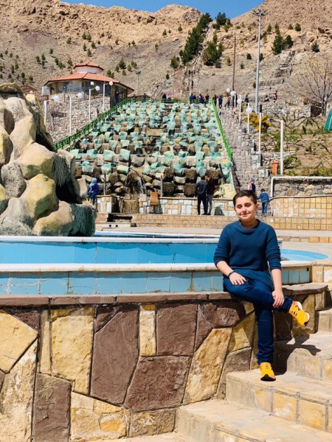
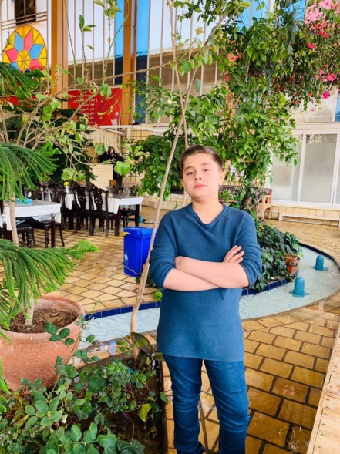
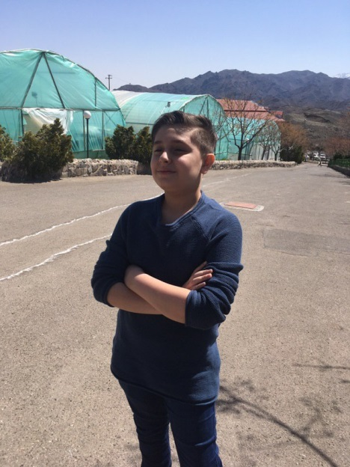
Ghasem Kashan
Ghamsar is a city located in the northwest of Isfahan province and south of Kashan, and is a door with dimensions of 9 and 5 km. Ghamsar reputation is based on the reputation of Gulab and the quality of its flowers. Due to the climate and soil suitable for the flower of Mohammadi it has a lot of quality. In the years 1354-1352, Bulgarian experts discovered that Mohammadi Ghamsar had a spectacular look at the quality of the samples in other parts of the country. Therefore, some of the world's most advanced perfume industries have been using the essential oils of the flower of Mohammadi Ghamsar. The name Ghamsar has also been captured in the form of "Ghamsar" and "Ghassar". The Qom component in Qamesar, with the term "koom" means "qanat", may not be unrelated. The discovery of several mysteries at the foot of the mountains of tears in the northeast of Qasir, dating back to the time of the Achaemenids, reinforces the premise that its history may be before Islam
Back
Home
Next

Slide 4
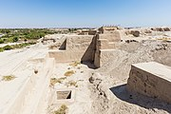
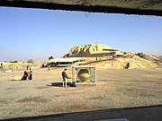
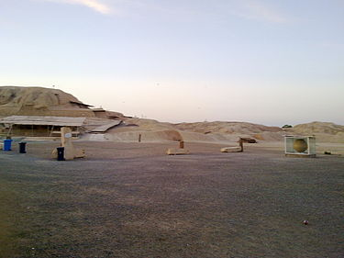
Kashan Silk Hills
Silk is the name of the first Central Iranian civilization in Kashan, southwest of Iran. The ancient Silk site, located in the Fin of Kashan, is about 7,000 years old. This hill is the ruins of the ancient ziggurat of Iran.
Nearly five thousand thousand BC, the Iranian plateau cavemen, following the climate change and the formation of fields and grasslands, turned to plains and began a new life, and in their civilization more progress than in previous periods It was seen; the oldest people in Dekhteh, the people of Silk were near Kashan, where they acquired the works of their life there.
Silk is one of the important archaeological sites of the Iranian plateau, which was formed in about 5,500 BC, one of the oldest settlements on the central plateau of Iran.
Back
Home
Next

Slide 5
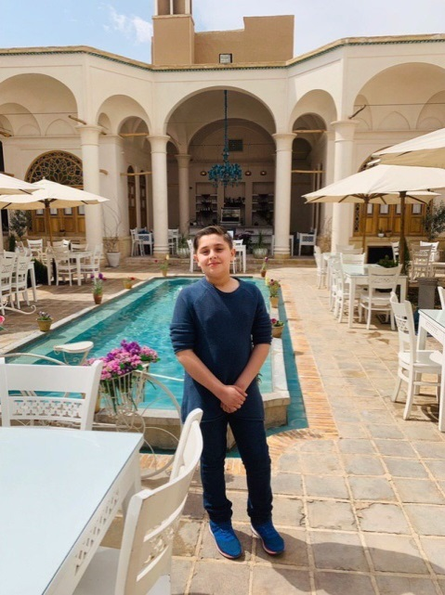
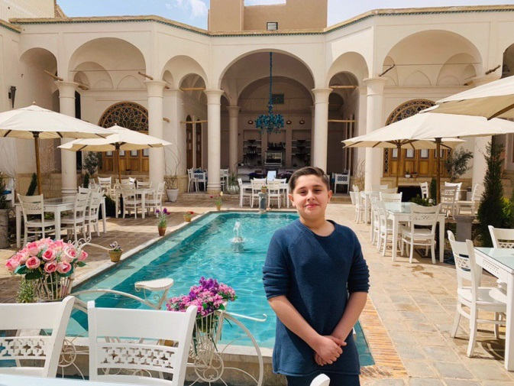
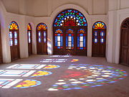
Historical houses of Kashan
The Tabatabai house, registered under number 1504, was constructed by Haj Seyyed Ja'far Tabatabai, Natanzi of Natanzian merchants residing in Kashan, in the Sultan Amir Ahmad neighborhood in the second half of the 13th century.
Its architect, Master Ali Maryam Kashani, and his paintings and paintings were performed by students of Mirza Abolhassan Senni-o-Molk Ghaffari Kashani and under his supervision.
Back
Home
Next

Slide 6
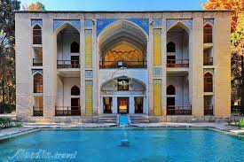
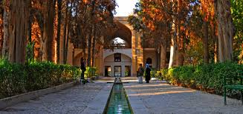
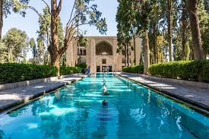
Fin of Kashan Garden
Fin bath is in the Fin of Kashan. The old bath is famous for the murder of Mirza Taghikhan Amir Kabir, Chancellor Nasser al-Din Shah Qajar on January 20, 1230 AH.
In the southern part of the Fin Garden there are two bathrooms known as the Small and Large Baths. The small bath of the Safavid period has been built along with the original Garden of Fine. The great bath in the Qajar era was created by Fath Ali Shah.
A large bathroom with a small bathroom and a small bathroom dedicated to the use of the kitchen. In each of the bathrooms, there are sections of the entrance, warm house, waterfront, aka, a place of cleaning and a dressing room. There are channels for changing the pools and ponds on the floor of the baths. The walls of the baths are covered with special moisture insulation (sand, lime). This bathroom has many corridors and walkways and has beautiful architecture.
Back
Home
Next

Slide 7
END

